Slide 1
תרגול 3
פונקציות
Maroun Tork, 2018

Slide 2
Register Names
Name | Reg # | Use | Saver
X0 | 0 | Constant 0 | -
ra | 1 | Return Address | Caller
sp | 2 | Stack Pointer | Callee
gp | 3 | Global Pointer | -
tp | 4 | Thread Pointer | -
t0-t2 | 5-7 | Temp | Caller
s0-s1 | 8-9 | Saved Registers | Callee
a0-a7 | 10-17 | Function arguments/ return values (0-1) | Caller
s2-s11 | 18-27 | Saved Registers | Callee
t3-t6 | 28-31 | Temp | Caller

Slide 3
Pre-call
גיבוי רגיסטרים שלא נשמרים (ti, ai, ra) למחסנית
הכנת ארגומנטים לפונקציה ב- a0-a7
העברת שליטה לפונקציה ושמירת כתובת החזרה ב- ra ע"י jal
פונקציה קוראת
Prologue
הקצאת זיכרון מחסנית ע"י הקטנת sp
גיבוי רגיסטרים "שמורים" si
prologue
Function
Body
תוכן הפונקציה
פונקציה נקראת
pre-call
Epilogue
הכנת ערכי החזרה ב- a0,a1
שחזור רגיסטרים שמורים si מהמחסנית
שחרור הזיכרון שהוקצה ע"י הגדלת sp
החזרת שליטה לפונקציה הקוראת ע"י jr ra
call
post-call
epilogue
Post-call
שחזור רגיסטרים שלא נשמרים (ti, ai, ra) מהמחסנית
פונקציה קוראת

Slide 4
זיכרון
בתחילת ריצת הפונקציה (prologue) עדיין לא נוכל לכתוב למחסנית. הכתובת שאליה מצביע sp שייכת לפונקציה אחרת (הקוראת)
$$⋮$$
כדי להקצות מקום נקטין את :sp
0x2014
לא שלנו!
SP=0x2014
addi sp, sp, -8
שלנו
s1
0x2010
s1
s0
SP=0x200c
כעת לפונקציה שלנו יש הקצאת זיכרון בגודל 8 בתים (שתי מילים). נוכל להשתמש בזיכרון לצרכי הפונקציה. למשל גיבוי s0 ו- s1:
s0
0x200c
שלנו
0x2008
sw s0, 0(sp)
0x2004
sw s1, 4(sp)
0x2000
$$⋮$$
בסיום ריצת הפונקציה (epilogue), נחזיר את sp לערכו המקורי (אין צורך לאפס את המידע שכתבנו למחסנית)
addi sp, sp, 8

Slide 5
Fundamental steps in calling a function
Caller pre-call:
1- Caller saves the registers which are not preserved on call, which will be needed for farther use after the return from the called function. (arguments/return registers a0-a7, ra, “temporary registers” t0-t6).
2- Caller puts parameters in a place where function can access them (Registers a0-a7).
3- Caller saves the address of next instruction to register ra (return address) and then transfers the control to the function by jumping to the function’s code (using jal).

Slide 6
Fundamental steps in calling a function
Callee prologue:
1- The called function (callee) acquires local storage (stack) resources needed, by decrementing the sp.
2- The called function (callee) stores preserved on call registers (“saved registers” s0-s11) that will be used by the function in the stack.

Slide 7
Fundamental steps in calling a function
The function performs the desired tasks

Slide 8
Fundamental steps in calling a function
Callee epilogue:
1- The called function (callee) puts the result values in the registers a0-a1 where calling code can access it.
2- The function restores any registers it used from the preserved on call registers.
3- The function frees the local storage, by incrementing the sp.
4- The function returns the control to point of origin of the caller (according to register ra, using jr).

Slide 9
Fundamental steps in calling a function
Caller post-call:
1- Caller restores the registers which are not preserved on call which it stored previous to the call. (arguments/return registers a0-a7, ra, “temporary registers” t0-t6).

Slide 10
Questions
A. How do we pass arguments into functions?
Use the 8 arguments registers a0 – a7
B. How are values returned by functions?
Use a0 and a1 as the return value registers
C. What is sp and how should it be used in the context of RISC-V functions?
sp stands for stack pointer. We subtract from sp to create more space and add to free space. The stack is mainly used to save (and later restore) the value of registers that may be overwritten.

Slide 11
Questions
D. Which values need to be saved before using jal?
Registers a0 – a7, t0 – t6, and ra
E. Which values need to be restored before using jr to return from a function?
Registers sp, gp, tp, and s0 – s11

Slide 12
Example
... sum(a,b);... /* a,b:s0,s1 */ int sum(int x, int y) { return x+y; }
address (shown in decimal) 1000 1004 1008 1012 1016 … 2000 2004
In RISC-V, all instructions are 4 bytes, and stored in memory just like data. So here we show the addresses of where the programs are stored.

Slide 13
Example
... sum(a,b);... /* a,b:s0,s1 */ int sum(int x, int y) { return x+y; }
address (shown in decimal) 1000 mv a0,s0 # x = a 1004 mv a1,s1 # y = b 1008 addi ra,zero,1016 #ra=1016 1012 j sum #jump to sum 1016 … # next instruction … 2000 sum: add a0,a0,a1 2004 jr ra # new instr. “jump register”
Notes:
Code is behind white boxes
Prepare the function arguments a0, a1
RA – computation of the return address for function.
SUM result goes to a0, which is now employed for “return value”
JR – jump register

Slide 14
Example
... sum(a,b);... /* a,b:s0,s1 */ int sum(int x, int y) { return x+y; }
Question: Why use jr here? Why not use j?
Answer: sum might be called by many places, so we can’t return to a fixed place. The calling proc to sum must be able to say “return here” somehow.
Notes:
Function code re-use

Slide 15
Example (Cont.)
Single instruction to jump and save return address: jump and link (jal)
Before: 1008 addi ra,x0,1016 #ra=1016 1012 j sum #goto sum
After: 1008 jal sum # ra=1012,goto sum
Why have a jal?
Make the common case fast: function calls very common
Reduce program size
Don’t have to know where code is in memory with jal!
Notes:
Additional
JAL = Jump and Link – single instruction instead of 2 we did before: saves RA and jumps
Historical Jump and Link, actually does Link and then Jump.
Don’t have to know where code is in memory with jal! → special HW will calculate RA according to current PC.

Slide 16
Question 1
int Leaf(int g, int h, int i, int j){
int f;
f = (g + h) – (i + j);
return f;
}
Parameter variables g, h, i, and j in argument registers a0, a1, a2, and a3
f in register s0
Assume we need one temporary register s1
Write the RISC-V code for Leaf
Notes:
S0, S1 – just general registers in this case.
Caller who called Leaf, should save aside previous values of a0-a3, s0-s1

Slide 17
RISC-V Code for Leaf()
Leaf: addi sp,sp,-8 # adjust stack for 2 items
sw s1, 4(sp) # save s1 for use afterwards
sw s0, 0(sp) # save s0 for use afterwards
add s0,a0,a1 # f = g + h
add s1,a2,a3 # s1 = i + j
sub a0,s0,s1 # return value (g + h) – (i + j)
lw s0, 0(sp) # restore register s0 for caller
lw s1, 4(sp) # restore register s1 for caller
addi sp,sp,8 # adjust stack to delete 2 items
jr ra # jump back to calling routine
Prologue
Task
Epilogue
Notes:
S0, S1 – temp registers.
First of all save aside in stack previous values of S0, S1
Move stack pointer down
Save previous value of s0, s1
This is a Callee responsibility, since only Callee knows that it changes s0, s1
The do the functional code… return value → to a0
The first part is called “Prolog”
The last part is called “Epilog”
Delete operation: moving SP back up.

Slide 18
Stack Before, During, After Function
We need to save old values of s0 and s1
sp
sp
Saved s1
Saved s1
sp
Saved s0
Saved s0
Before call
During call
After call

Slide 19
What If a Function Calls a Function? Recursive Function Calls?
int fact (unsigned int n) { if (n == 0) return 1; return n * fact(n-1); }
int main() { return fact(3); }
Notes:
Two cases
Function a calls function b
Function a calls function a

Slide 20
Questions
int fact (unsigned int n) { if (n == 1) return (1); return n * fact(n-1); }
int main() { return fact(3); }
A. (prologue main) – What is the needed space in the stack for the main?
4 bytes only (for register ra, which is about to be changed when calling fact).
B. (pre-call main) - What argument will main send to fact and how?
Before main calls fact, it stores the argument 3 to register a0.
Notes:
Two cases
Function a calls function b
Function a calls function a

Slide 21
Questions
int fact (unsigned int n) { if (n == 1) return (1); return n * fact(n-1); }
int main() { return fact(3); }
C. (pre-call fact(n)) - What argument will fact(n) send to fact(n-1) and how?
Before fact(n) calls fact(n-1), it stores the argument n-1 to register a0.
D. (pre-call fact(n)) - Which values has to be saved before fact(n) calls fact(n-1)?
Registers ra and a0, since they are about to be changed when calling fact(n-1).
E. What is the needed space in the stack for fact(n)?
8 bytes, for registers ra and a0.
Notes:
Two cases
Function a calls function b
Function a calls function a

Slide 22
Questions
int fact (int n) { if (n < 1) return (1); return (n * fact(n-1)); }
main() { return (fact(3)); }
F. How many different frames will be defined in the stack?
A single frame for main and a frames for each time fact(n) is called, where n=0,1,2,3. Therefore 5 frames in total.
J. How many different values will register ra receive?
3 different values will be stored in register ra: the address of the operating system that called main the address of main that called fact(3) the (same) address of fact(n) that called fact(n-1), for n=3,2,1.
Notes:
Two cases
Function a calls function b
Function a calls function a

Slide 23
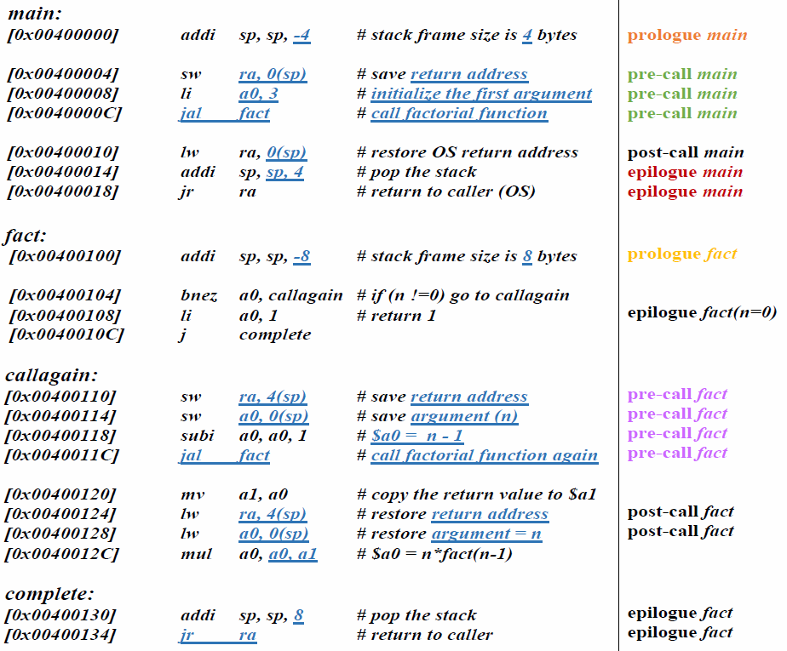


Registers
Register | Content
ra
a0
a1 | 0
sp
address of PC+4 of OS
0
int fact (unsigned int n) { if (n == 1) return (1); return n * fact(n-1); }
int main() { return fact(3); }
0x bfff 0000
0x bffe fffc
Stack
Address | Content
0x bfff 0000
0x bffe fffc
0x bffe fff8
0x bffe fff4
0x bffe fff0
0x bffe ffec
0x bffe ffe8
0x bffe ffe4
0x bffe ffe0
0x bffe ffdc
sp$→$
sp$→$
Frame
main

Slide 24
Registers
Register | Content
ra
a0
a1 | 0
sp
0x00400010
address of PC+4 of OS
0
3
int fact (unsigned int n) { if (n == 1) return (1); return n * fact(n-1); }
int main() { return fact(3); }
0x bfff fffc
Stack
Address | Content
0x bfff 0000
0x bffe fffc
0x bffe fff8
0x bffe fff4
0x bffe fff0
0x bffe ffec
0x bffe ffe8
0x bffe ffe4
0x bffe ffe0
0x bffe ffdc
sp$→$
ra = address of PC+4 of OS
Frame
main

Slide 25

Registers
Register | Content
ra
a0
a1 | 0
sp
0x00400010
3
int fact (unsigned int n) { if (n == 1) return (1); return n * fact(n-1); }
int main() { return fact(3); }
0x bfff fffc
0x bfff fff4
Stack
Address | Content
0x bfff 0000
0x bffe fffc
0x bffe fff8
0x bffe fff4
0x bffe fff0
0x bffe ffec
0x bffe ffe8
0x bffe ffe4
0x bffe ffe0
0x bffe ffdc
sp$→$
ra = address of PC+4 of OS
Frame
main
Frame fact(n=3)
sp$→$

Slide 26
Registers
Register | Content
ra
a0
a1 | 0
sp
0x00400120
0x00400010
3
2
int fact (unsigned int n) { if (n == 1) return (1); return n * fact(n-1); }
int main() { return fact(3); }
0x bfff fff4
Stack
Address | Content
0x bfff 0000
0x bffe fffc
0x bffe fff8
0x bffe fff4
0x bffe fff0
0x bffe ffec
0x bffe ffe8
0x bffe ffe4
0x bffe ffe0
0x bffe ffdc
ra = address of PC+4 of OS
Frame
main
ra = 0x00400010
Frame fact(n=3)
sp$→$
a0 = 3

Slide 27

Registers
Register | Content
ra
a0
a1 | 0
sp
0x00400120
1
2
int fact (unsigned int n) { if (n == 1) return (1); return n * fact(n-1); }
int main() { return fact(3); }
0x bfff fff4
0x bfff ffec
Stack
Address | Content
0x bfff 0000
0x bffe fffc
0x bffe fff8
0x bffe fff4
0x bffe fff0
0x bffe ffec
0x bffe ffe8
0x bffe ffe4
0x bffe ffe0
0x bffe ffdc
ra = address of PC+4 of OS
Frame
main
ra = 0x00400010
Frame fact(n=3)
sp$→$
a0 = 3
ra = 0x00400120
Frame fact(n=2)
sp$→$
a0 = 2

Slide 28


Registers
Register | Content
ra
a0
a1 | 0
sp
0x00400120
0
1
int fact (unsigned int n) { if (n == 1) return (1); return n * fact(n-1); }
int main() { return fact(3); }
0x bfff ffe4
0x bfff ffec
Stack
Address | Content
0x bfff 0000
0x bffe fffc
0x bffe fff8
0x bffe fff4
0x bffe fff0
0x bffe ffec
0x bffe ffe8
0x bffe ffe4
0x bffe ffe0
0x bffe ffdc
ra = address of PC+4 of OS
Frame
main
ra = 0x00400010
Frame fact(n=3)
a0 = 3
ra = 0x00400120
Frame fact(n=2)
sp$→$
a0 = 2
ra = 0x00400120
Frame fact(n=1)
sp$→$
a0 = 1

Slide 29


Registers
Register | Content
ra
a0
a1 | 0
sp
0x00400120
0
1
int fact (unsigned int n) { if (n == 1) return (1); return n * fact(n-1); }
int main() { return fact(3); }
0x bfff ffe4
0x bfff ffdc
Stack
Address | Content
0x bfff 0000
0x bffe fffc
0x bffe fff8
0x bffe fff4
0x bffe fff0
0x bffe ffec
0x bffe ffe8
0x bffe ffe4
0x bffe ffe0
0x bffe ffdc
ra = address of PC+4 of OS
Frame
main
ra = 0x00400010
Frame fact(n=3)
a0 = 3
ra = 0x00400120
Frame fact(n=2)
a0 = 2
ra = 0x00400120
Frame fact(n=1)
sp$→$
a0 = 1
Frame fact(n=0)
sp$→$

Slide 30
Registers
Register | Content
ra
a0
a1 | 0
sp
0x00400120
1
int fact (unsigned int n) { if (n == 1) return (1); return n * fact(n-1); }
int main() { return fact(3); }
0x bfff ffe4
0x bfff ffdc
Stack
Address | Content
0x bfff 0000
0x bffe fffc
0x bffe fff8
0x bffe fff4
0x bffe fff0
0x bffe ffec
0x bffe ffe8
0x bffe ffe4
0x bffe ffe0
0x bffe ffdc
ra = address of PC+4 of OS
Frame
main
ra = 0x00400010
Frame fact(n=3)
a0 = 3
ra = 0x00400120
Frame fact(n=2)
a0 = 2
ra = 0x00400120
Frame fact(n=1)
sp$→$
a0 = 1
Frame fact(n=0)
sp$→$

Slide 31
Registers
Register | Content
ra
a0
a1
sp
0x00400120
1
0
1
int fact (unsigned int n) { if (n == 1) return (1); return n * fact(n-1); }
int main() { return fact(3); }
0x bfff ffe4
Stack
Address | Content
0x bfff 0000
0x bffe fffc
0x bffe fff8
0x bffe fff4
0x bffe fff0
0x bffe ffec
0x bffe ffe8
0x bffe ffe4
0x bffe ffe0
0x bffe ffdc
ra = address of PC+4 of OS
Frame
main
ra = 0x00400010
Frame fact(n=3)
a0 = 3
ra = 0x00400120
Frame fact(n=2)
a0 = 2
ra = 0x00400120
Frame fact(n=1)
sp$→$
a0 = 1
Frame fact(n=0)

Slide 32


Registers
Register | Content
ra
a0
a1
sp
0x00400120
1
1
int fact (unsigned int n) { if (n == 1) return (1); return n * fact(n-1); }
int main() { return fact(3); }
0x bfff ffe4
0x bfff ffec
Stack
Address | Content
0x bfff 0000
0x bffe fffc
0x bffe fff8
0x bffe fff4
0x bffe fff0
0x bffe ffec
0x bffe ffe8
0x bffe ffe4
0x bffe ffe0
0x bffe ffdc
ra = address of PC+4 of OS
Frame
main
ra = 0x00400010
Frame fact(n=3)
a0 = 3
ra = 0x00400120
Frame fact(n=2)
sp$→$
a0 = 2
ra = 0x00400120
Frame fact(n=1)
sp$→$
a0 = 1

Slide 33
Registers
Register | Content
ra
a0
a1
sp
0x00400120
2
1
1
int fact (unsigned int n) { if (n == 1) return (1); return n * fact(n-1); }
int main() { return fact(3); }
0x bfff ffec
Stack
Address | Content
0x bfff 0000
0x bffe fffc
0x bffe fff8
0x bffe fff4
0x bffe fff0
0x bffe ffec
0x bffe ffe8
0x bffe ffe4
0x bffe ffe0
0x bffe ffdc
ra = address of PC+4 of OS
Frame
main
ra = 0x00400010
Frame fact(n=3)
a0 = 3
ra = 0x00400120
Frame fact(n=2)
sp$→$
a0 = 2

Slide 34

Registers
Register | Content
ra
a0
a1
sp
0x00400120
2
1
int fact (unsigned int n) { if (n == 1) return (1); return n * fact(n-1); }
int main() { return fact(3); }
0x bfff fff4
0x bfff ffec
Stack
Address | Content
0x bfff 0000
0x bffe fffc
0x bffe fff8
0x bffe fff4
0x bffe fff0
0x bffe ffec
0x bffe ffe8
0x bffe ffe4
0x bffe ffe0
0x bffe ffdc
ra = address of PC+4 of OS
Frame
main
ra = 0x00400010
Frame fact(n=3)
sp$→$
a0 = 3
ra = 0x00400120
Frame fact(n=2)
sp$→$
a0 = 2

Slide 35
Registers
Register | Content
ra
a0
a1
sp
0x00400120
0x00400010
6
2
3
2
1
int fact (unsigned int n) { if (n == 1) return (1); return n * fact(n-1); }
int main() { return fact(3); }
0x bfff ffec
Stack
Address | Content
0x bfff 0000
0x bffe fffc
0x bffe fff8
0x bffe fff4
0x bffe fff0
0x bffe ffec
0x bffe ffe8
0x bffe ffe4
0x bffe ffe0
0x bffe ffdc
ra = address of PC+4 of OS
Frame
main
ra = 0x00400010
Frame fact(n=3)
sp$→$
a0 = 3

Slide 36

Registers
Register | Content
ra
a0
a1
sp
0x00400010
6
2
int fact (unsigned int n) { if (n == 1) return (1); return n * fact(n-1); }
int main() { return fact(3); }
0x bfff fff4
0x bfff fffc
Return to main with $a0=6=3!
Stack
Address | Content
0x bfff 0000
0x bffe fffc
0x bffe fff8
0x bffe fff4
0x bffe fff0
0x bffe ffec
0x bffe ffe8
0x bffe ffe4
0x bffe ffe0
0x bffe ffdc
ra = address of PC+4 of OS
Frame
main
sp$→$
ra = 0x00400010
Frame fact(n=3)
sp$→$
a0 = 3

Slide 37

Registers
Register | Content
ra
a0
a1
sp
address of PC+4 of OS
0x00400010
6
2
int fact (unsigned int n) { if (n == 1) return (1); return n * fact(n-1); }
int main() { return fact(3); }
0x bfff fffc
0x bfff 0000
Stack
Address | Content
0x bfff 0000
0x bffe fffc
0x bffe fff8
0x bffe fff4
0x bffe fff0
0x bffe ffec
0x bffe ffe8
0x bffe ffe4
0x bffe ffe0
0x bffe ffdc
sp$→$
ra = address of PC+4 of OS
Frame
main
sp$→$

Slide 38
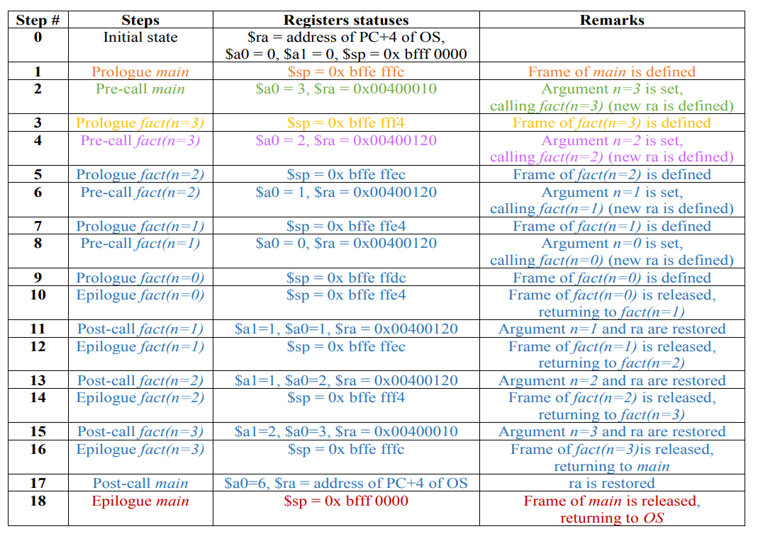
Notes:
There is one more table, See the pdf

Slide 39
Questions
int fact (int n) { if (n < 1) return (1); return (n * fact(n-1)); }
main() { return (fact(3)); }
Draw all necessary arrows to complete the flow of the previous code (program):
main
fact(n=3)
fact(n=2)
fact(n=1)
fact(n=0)
Prologue
Prologue
Prologue
Prologue
Prologue
Pre-call
Pre-call
Pre-call
Pre-call
Post-call
Post-call
Post-call
Post-call
Epilogue
Epilogue
Epilogue
Epilogue
Epilogue
Notes:
Two cases
Function a calls function b
Function a calls function a

Slide 40
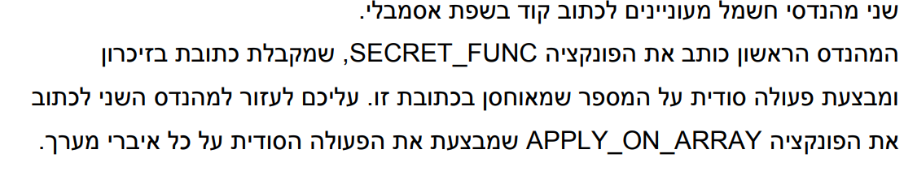
שאלה ממבחן – תשע"ט חורף מועד א'

Slide 41
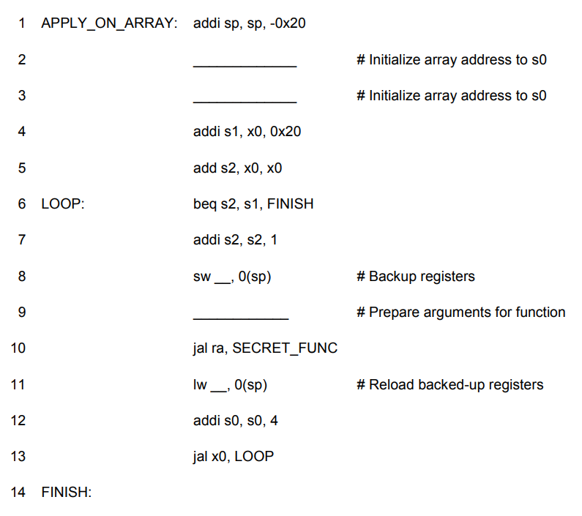
שאלה ממבחן – תשע"ט חורף מועד א'
1
lui s0, 0x20
2
ra
3
add a0, x0, s0
4
ra

Slide 42
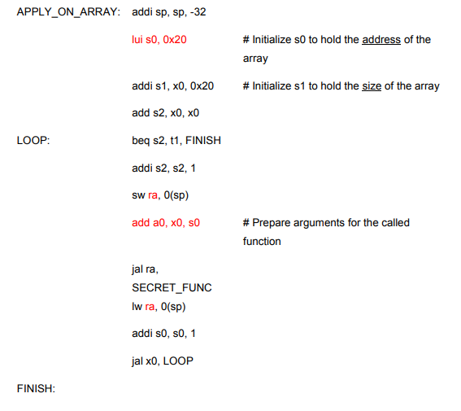
שאלה ממבחן – תשע"ט חורף מועד א'
האם הקוד מקיים קונבנציית הקריאה לפונקציה? הסבר. אם לא, תאר אילו שינויים נדרשים על מנת שהקוד ירוץ לפי הקונבנציה.
על מנת שהפונקציה תרוץ לפי קונבנציית הקריאה לפונקציה, נדרש:
לגבות את s2,s1,s0 בתחילת הריצה, ולהחזיר אותם לערך הראשוני בסוף הריצה.
לשחרר את המחסנית בסוף התוכנית.

